Slide 1


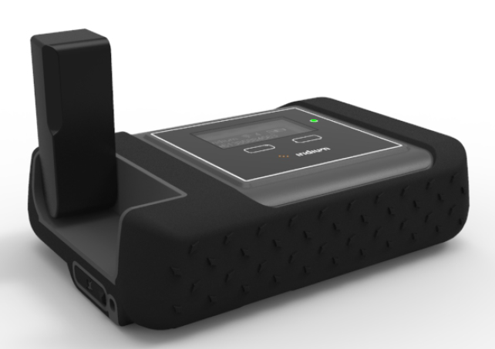
Iridium GO! Training

Slide 2
Iridium GO! Key Features
Feature | Description
Connectivity | Apple and Android devices will now work anywhere on the planet. The first ever reliable global voice and data connection with pole to pole Iridium coverage. Connects up to 5 mobile devices (single user at a time).
Simplicity | Simple and easy to use. No worries. No roaming charges.
Optimized | An all-in-one solution that supports: Voice calling SMS/text messaging Email GPS positioning Online tracking Emergency SOS
Ruggedized | Jet water resistant, shock resistant and dust proof (IP65 rated). Portable and chargeable with battery life of up to 5.5 hours.

Slide 3
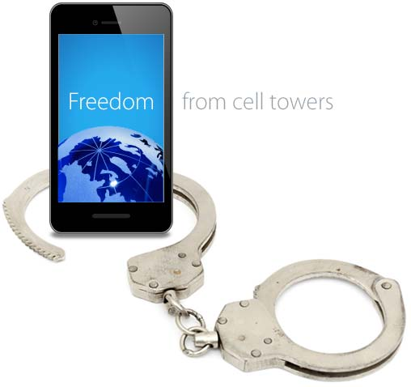
Iridium GO! Positioning
Versatile
Iridium GO! supports a full range of global communications, including:
Voice calls Email access Applications Social networking | Photo sharing SMS two-way GPS tracking SOS alerts
Simple
Easy to Use, stable, lay-flat design, flip up antenna and built-in menu/status display.
Mobile
Powered by the world's furthest reaching network, dramatically extend the capabilities of your personal devices by creating a reliable satellite connection – anywhere on the planet.
Innovative
It’s like having your very own global cell tower – only much easier to pack.
Affordable
Iridium GO! is an affordable solution for global connectivity, delivering remarkable value compared to other options.

Slide 4
Iridium GO! Tech Specs
Key technical specifications are listed below, more detailed specifications are available in the Iridium GO! Technical Specs Document.
Dimensions | 81.7 X 119.81 X 33.44 mm
Weight with Battery | 305 g
Ingress Protection (IP) | IP65
Temperature Ranges | -10C to +50C (Operational), -20C to +60C (Storage)
Wi-Fi Frequency & Range | up to 30.5 meters or 100 feet (2.4 Ghz b, g, n)
Included GO! Applications | Iridium GO! (Phone, SMS, SOS) Iridium GO! Mail & Web (Mail, Web, Weather)
# of Users | Up to 5 can connect with Iridium GO! app
Battery Specs | 3600 mAh providing up to 5.5 hrs talk time / up to 15.5 standby
Battery Charge Time | 4 hours
Interface Connectors | SIM, micro USB, External Antenna
External Antenna Adapter | TS-9 (TS-9 to TNC adapter available)

Slide 5

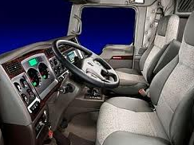


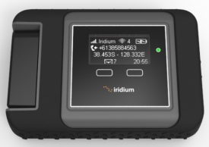

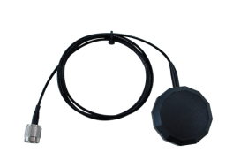

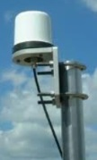
Iridium GO! Use Options
This hotspot device is portable and can be used in a variety of situations:
1
Portable
2
In-Vehicle
3
In-Building
For additional information on these configuration options, you can download the Iridium GO! Accessories Sales Sheet or refer to the Iridium GO! User Manual.

Slide 6
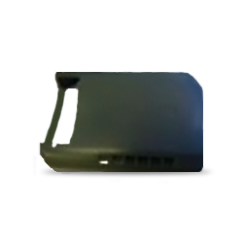
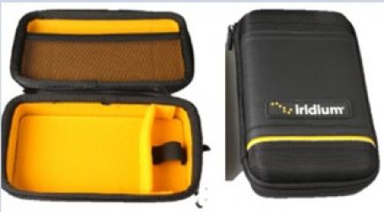
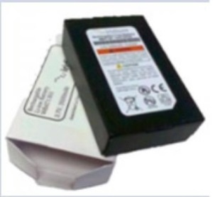
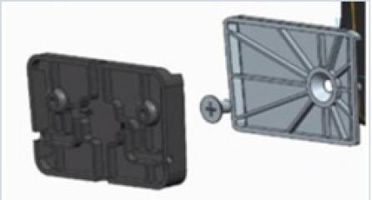
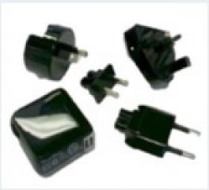
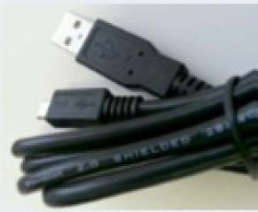
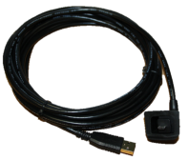
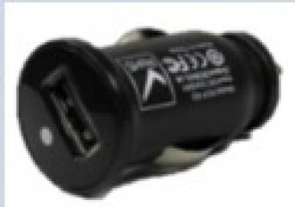

Iridium GO! Accessories
Iridium is launching a series of accessories specifically compatible with the Iridium GO!
Additional details and configurations can be found by referencing Roadpost’s Iridium GO! Accessories Sell Sheet.
Included Accessories:
Additional Accessories:
Carry Bag with carabiner
Protective
Cover
Battery
Wall Mount
AC Adapter Kit
USB Cable
5m Outdoor USB Cable
DC Auto Adapter
External Antenna Adapter

Slide 7


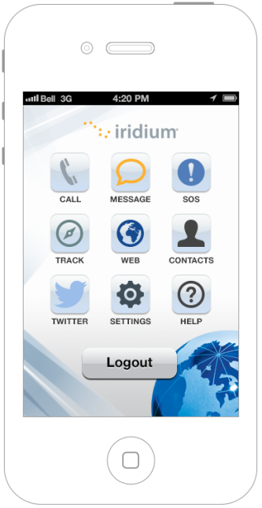
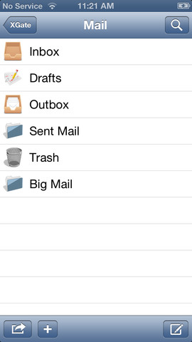


Iridium GO! Applications
Iridium GO! and Iridium GO! Mail & Web Apps will be available for download in iTunes and Google Play storefronts.
These apps are required to connect to your Iridium GO!
Iridium GO! App | Iridium GO! Mail & Web App
Apple iOS and Android Multiple Users (up to 5) Settings Phone calling & transfer Text messaging SOS button Tracking Twitter Contact Management In-App Help | Apple iOS and Android E-mail: <name>@my.iridium.net External account sync Compression Social media updates Weather In-App Help

Slide 8
Target Markets: Consumer
Segment | Value Proposition
Boaters | In shore and off shore boaters (25-60ft wind and gas), mostly weekend users who cannot live without connection (text, email and calls) to friends, family and work over a weekend. Obtain weather data, wind and currents.
Explorers | Weekend warriors: Hiker, biker, campers who are weekend warriors in their own backyard but travel out of terrestrial wireless coverage. Expedition and Outfitters: Serious vacation or longer time period adventurers.
Rural Residents | Small remote housing, outfitter or work installations offering basic email and phone calling capability.
Travelers | Retired Adventurers: Large numbers of Baby boomers are taking to the road in small RVs and exploring their own country’s. Cruise Ship Passengers: Call home and email without cost or hassle of visiting Internet Café.

Slide 9
Target Markets: Business
Segment | Value Proposition
Offices in Disaster-Prone Areas | Low cost option to enable businesses to connect in event of disaster. Can be installed or carried, increasing utility. Example locations include US Gulf, Japan, etc.
Expedition Leaders | Enable expedition leader to share and manage connection with customers who will value being able to connect to home and pay the expedition leader for usage.
Executive Roamers | Iridium is less expensive than roaming onto another carrier’s network ($2.50 vs $1.50) as long as large emails are not required.
Truckers | Truckers whose companies require productivity applications, such as dispatch, email or voice communications with the driver. In addition, vehicular monitoring can be accommodated with a smartphone or Tablet.
Pilots | Small aircraft/bush pilots require weather updates, navigation, DUATs and other aviation related data transfers in addition to email and voice communications while out of terrestrial coverage.

Slide 10
Target Markets: Government
Segment | Value Proposition
Provincial/ Local/ Federal Disaster Preparation | Connect to home country using own smartphone but with Iridium network for improved security (calls bypass local landlines).
Military | Welfare calling at forward operating bases and for rapid deployments so soldiers can stay connected to home (ex. like DnD).
State Department/Diplomats | Connect to home country using own smartphone but with Iridium network for improved security (calls bypass local landlines).
Special Operations | Important to have device that allows them to inconspicuously use their own smartphones to blend in (ex. hide and use own smartphone).

Slide 11
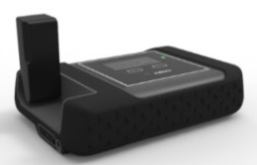
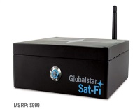
Mobile Data Product Comparison
 | Iridium GO! | IsatHub | Sat-Fi
Network | Iridium LEO | Geostationary | Globalstar LEO
Image
Coverage | 100% pole to pole global coverage | Nearly global coverage | US and Southern Canada
Features | Voice Calls, SMS, Email & Web SOS Emergency Button & GPS Photo Transfer, Weather, Social Network | Voice, SMS, data SmartApp, iOS & Android Multiple user support | Voice Calls Email Web GPS Positioning
Restrictions | Not IP Lower data speeds Requires optimised apps | Not recommended to use while moving No tracking | SOS button and SMS functionality not available at launch No internal battery, requires connectivity to power source
Mobility | Works stationary or on the move | Requires steady connection to satellite constellation | In-vehicle, requires connectivity to power source
Data speeds | Circuit Switched 2.4kbps and up to 9.6 kbps with Web & Mail app | Real-time IP data 384/240kbps | Up to 9.6 Kbps
Multi-user | Yes, up to 5 | Yes | Yes, up to 8 users
Size/weight | 114 x 82 x 32 mm - 305g | 179 x 170 x 30 mm - 850g | 160 x 160 x 61 mm
IP rating | IP65 | N/A | IP4
Dev. platform | Yes | Yes | No

